Slide 1
Image Colorization Using GANs
Transforming Grayscale Images to Color

Slide 2
Problem Statement
Grayscale images lack vivid, informative color details.
Manual colorization is time-consuming and subjective.
Achieving realistic colorization automatically is complex due to the ambiguity of color mapping for grayscale inputs.
Our aim is to develop a GAN-based model to automate and improve image colorization with realistic and scalable results.

Slide 3
Introduction
Image colorization is the process of adding color to grayscale images, enabling them to appear realistic and visually appealing.
Application
Restoring old black-and-white photographs.
Enhancing grayscale videos or films.
Artistic visualizations in AI.

Slide 4
Objectives
Develop a GAN-based approach to colorize grayscale images.
Achieve visually appealing and realistic results.
Evaluate performance against traditional colorization methods.

Slide 5
Dataset
We are using a dataset from Kaggle competition named XXX
This dataset has 7129 color and its corresponding image
Preprocessing:
To enhance dataset diversity and model robustness and reducing overfitting during training we are augmenting the data
Augmentation Techniques Used:
Horizontal Flip: Flips images horizontally (50% chance).
Rotation: Rotates images randomly within ±30°.
Brightness/Contrast Adjustment: Simulates lighting variations (50% chance).
Gaussian Blur: Adds slight blur (20% chance).

Slide 6
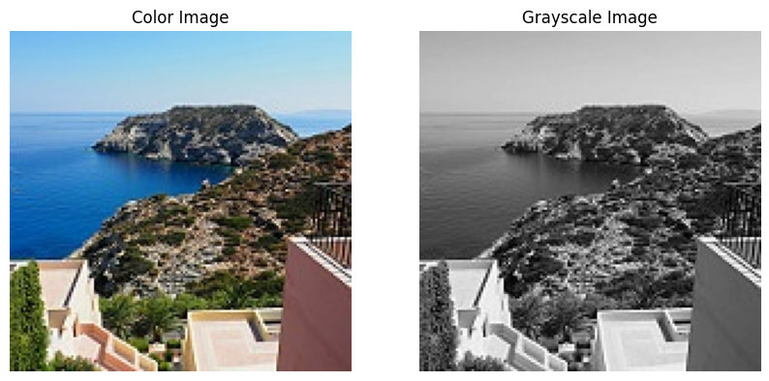
Dataset
We are using a dataset from Kaggle competition named XXX
This dataset has 7129 color and its corresponding image
Preprocessing:
To enhance dataset diversity and model robustness and reducing overfitting during training we are augmenting the data
Augmentation Techniques Used:
Horizontal Flip: Flips images horizontally (50% chance).
Rotation: Rotates images randomly within ±30°.
Brightness/Contrast Adjustment: Simulates lighting variations (50% chance).
Gaussian Blur: Adds slight blur (20% chance).

Slide 7
Model
We are using Generative Adversarial Networks (GANs) for this task
Generative Adversarial Networks (GANs):
Composed of two neural networks: Generator and Discriminator.
Generator: Creates realistic colorized images from grayscale inputs.
Discriminator: Distinguishes real images from generated ones.
How it Works:
Generator tries to "fool" the Discriminator by improving image realism.
Discriminator learns to correctly identify real vs. fake images.
Outcome:
A competitive framework where both networks improve over time, producing high-quality colorized images

Slide 8
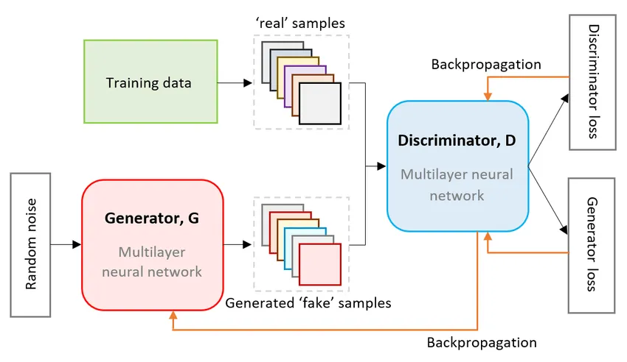
Model Workflow
GAN Mechanism
Generator (G): Creates fake samples to mimic real data.
Discriminator (D): Differentiates real and fake samples.
Training: Adversarial feedback loop improves both networks.
Goal: Generate realistic outputs indistinguishable from real data.

Slide 9
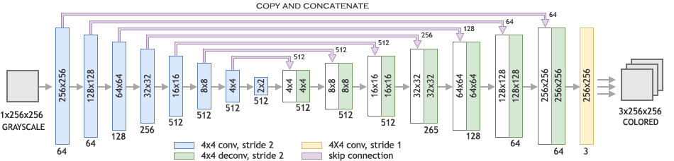
GAN Architecture
GAN model uses a U-Net structure with an encoder-decoder design, incorporating skip connections to retain spatial details. The encoder extracts features, while the decoder reconstructs them into a realistic 3-channel RGB image.

Slide 10
Model Training
Training Configuration:
Number of epochs: 50.
Batch size: 64.
Learning rate: 0.0002 using the Adam optimizer.
Loss Function
Adversarial loss: Balances the Generator and Discriminator.
Reconstruction loss: Ensures the generated images resemble real ones.
Challenges: Adjusting learning rates to prevent mode collapse.

Slide 11
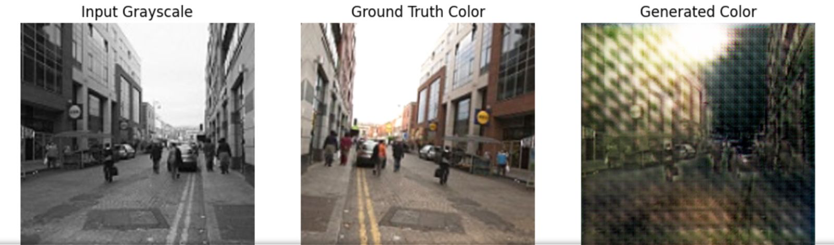
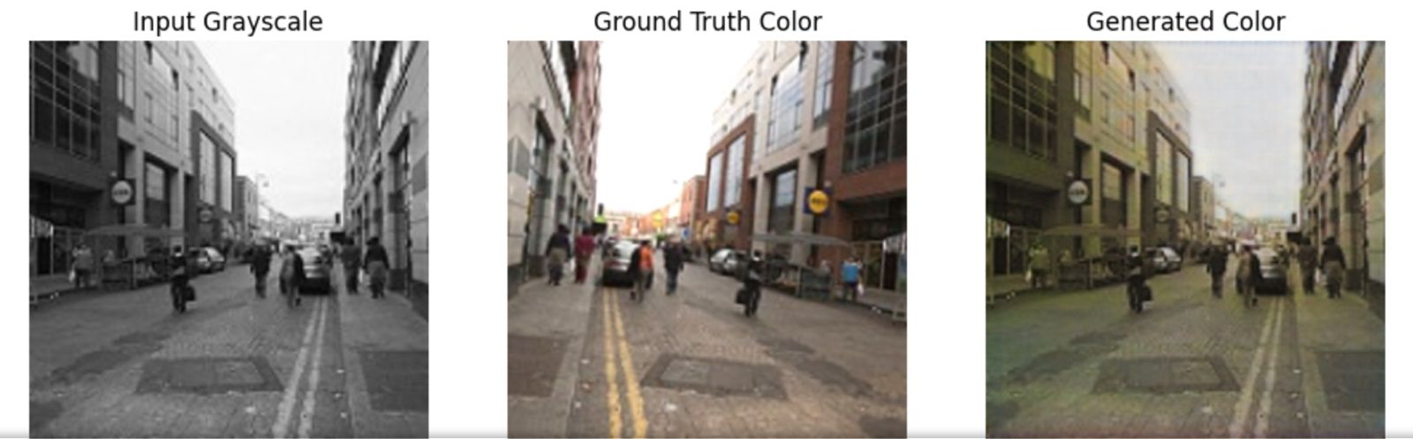
Sample outputs
Epoch-5
Epoch-45

Slide 12
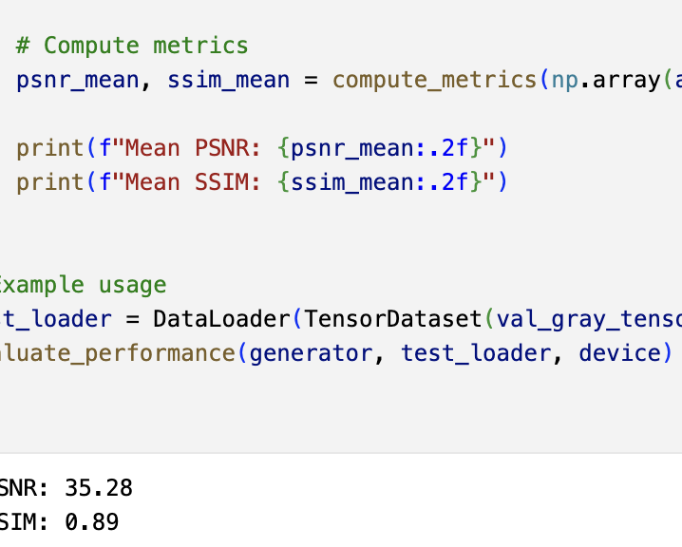
Results
Quantitative Results:
Structural Similarity Index (SSIM): Measures similarity between two images.
Achieved SSIM = 0.85.
Peak Signal-to-Noise Ratio (PSNR): Evaluates image quality.
Achieved PSNR = 28 dB

Slide 13
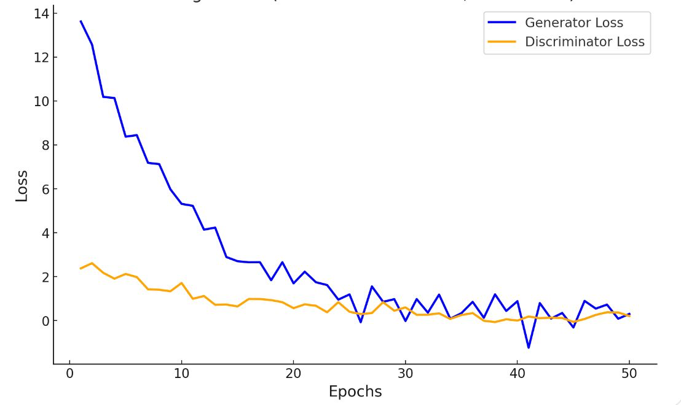
Results
Generator Loss starts at ~14 and decreases to ~0.5, showing improved image generation.
Discriminator Loss starts at ~2 and stabilizes around ~0.2, indicating effective distinction.
Balanced convergence reflects successful adversarial training by 50 epochs.
Training Loss Graph

Slide 14
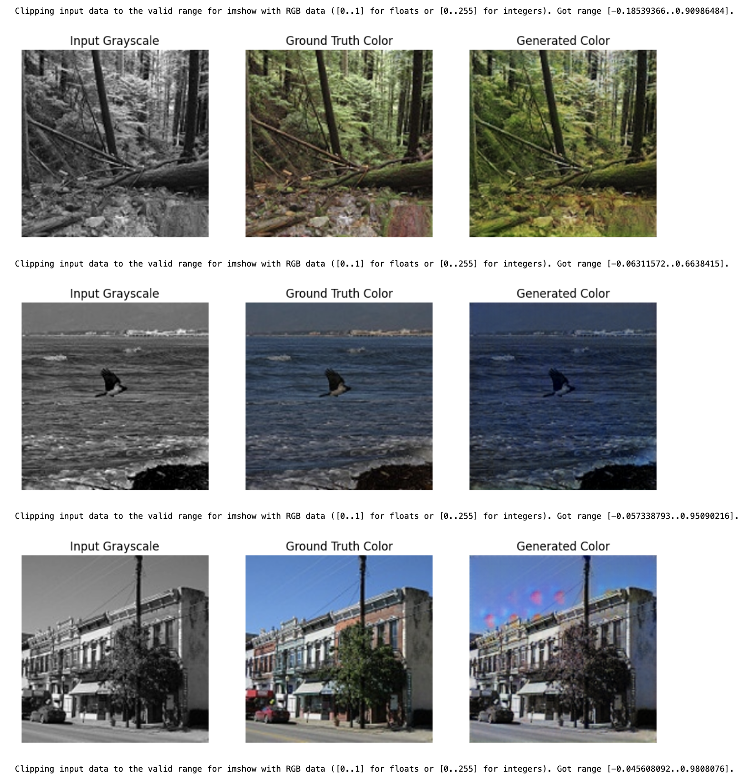
Test Data Results

Slide 15
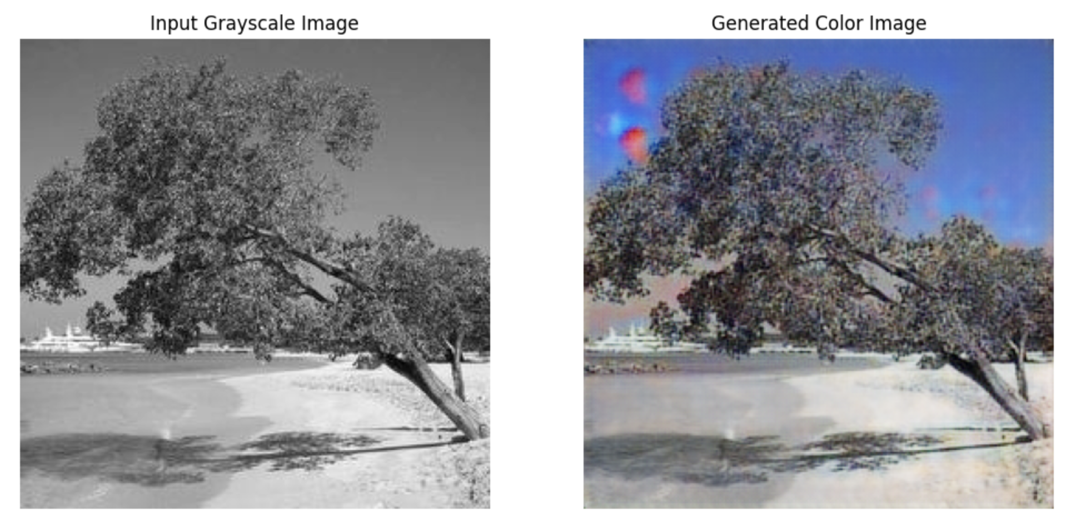
Results

Slide 16
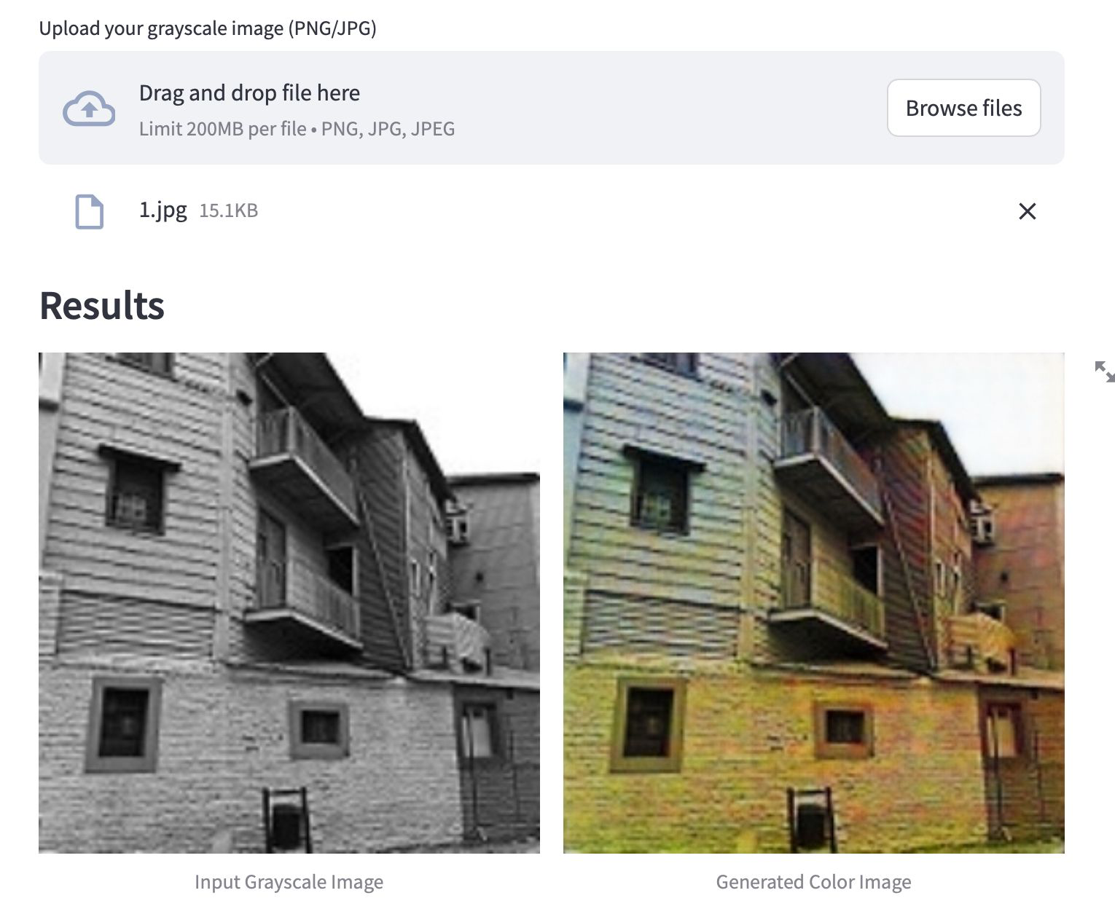
User Interface
We have developed UI using Streamlit
Streamlit UI allows users to upload grayscale (B/W) images.
The model generates and displays the corresponding colorized output.
Simple drag-and-drop feature ensures ease of use.

Slide 17
Conclusion
GANs demonstrate significant potential in automating image colorization.
Generated images are visually appealing and suitable for practical applications.
Future Improvements:
Experiment with Conditional GANs for incorporating semantic information.
Expand datasets to include more diverse images and even videos.
Optimize the training process to reduce computational costs.

Slide 18
Thank You ☺

